Slide 1
CS112: Object Oriented Programming
By Engr. Said Nabi

Slide 2

Instructor
Email: said.nabi@giki.edu.pk
Webpages: https://tecplace.net/ https://humanizetextai.com/
Office: NAB 2nd Floor, S22
Telephone Extension: 2154
Office Hours:
Monday/Thursday 9:00 AM - 4:00 PM

Slide 3

Course TA
Yet to be decide
Never hesitate to contact TA or me whenever you have some problem

Slide 4
Some Rules
There is only one rule that will make the rest of the rules
Raise your hand before asking any question and then WAIT for the permission
Never ever miss a class
Never ever “sleep” in the class
Never even think to use mobile phones in the class
Always communicate in the official communication language

Slide 5
Attendance
Students are required to attend 100% classes of courses registered and can not abstain from even a single class.
For circumstances beyond their control, students must apply for leave on prescribed Leave Application form.

Slide 6
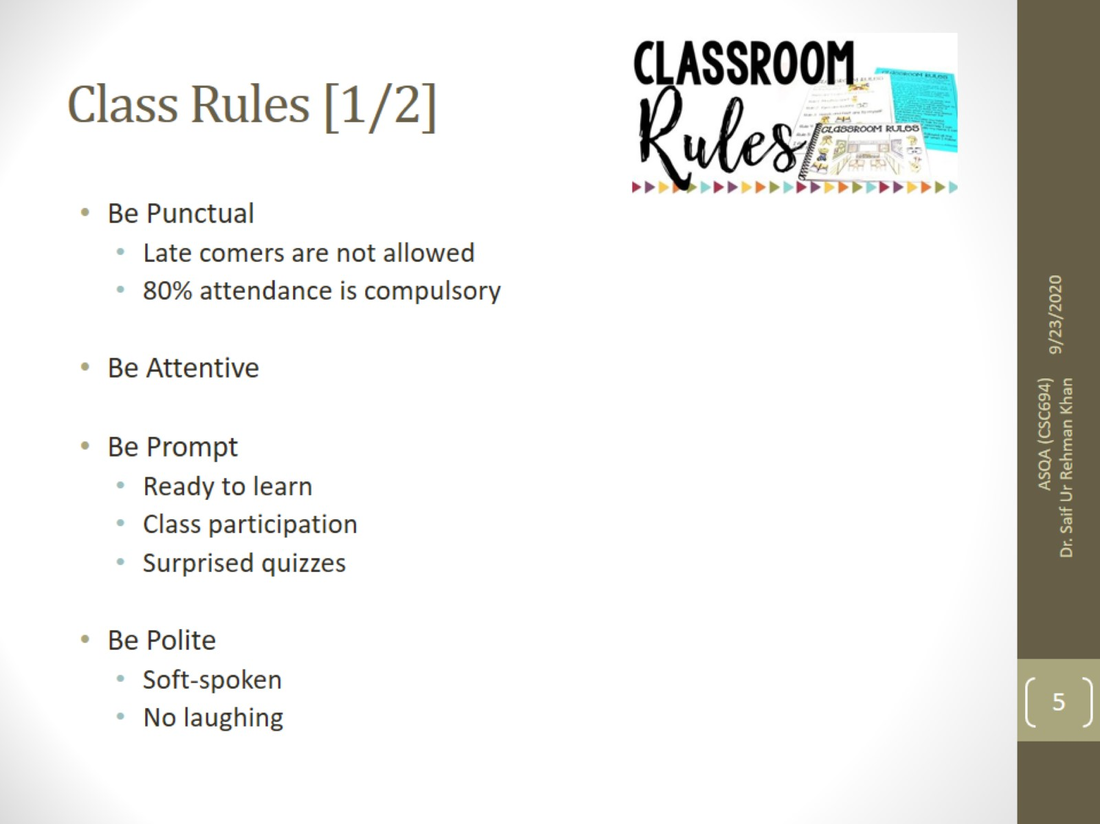
Class Rules [1/2]

Slide 7
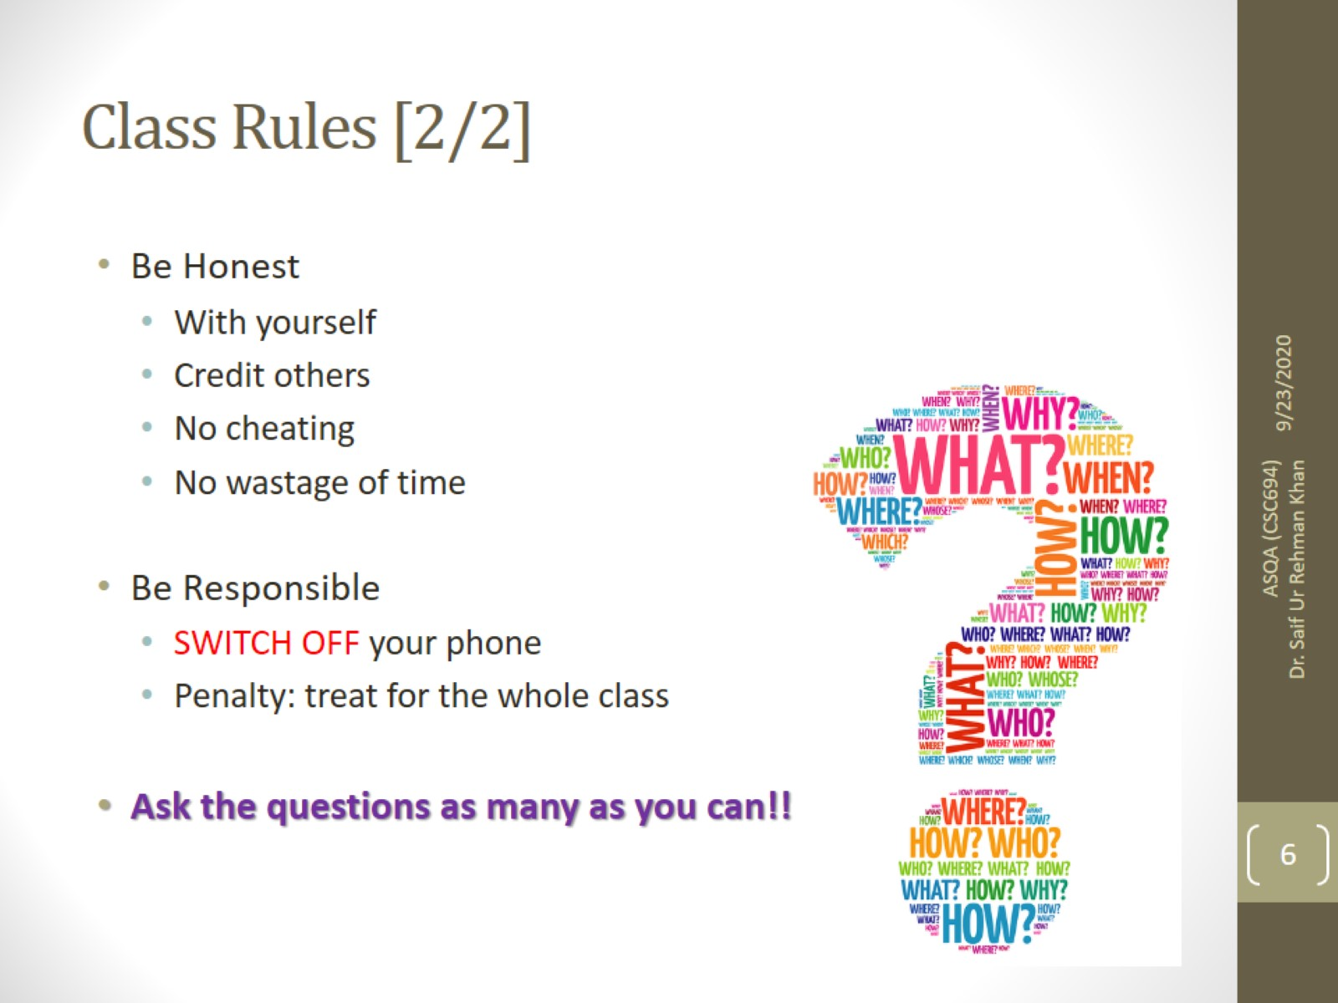
Class Rules [2/2]

Slide 8

Course Execution
3 lectures of one hour every week
1 lab of three hours every week, CS112L
Mind it: Lecture scheduling is to be done by the Dir. (A&E). Please avoid visiting me for any clashes

Slide 9
Notes
Course contents and their order may be slightly modified during the course execution.
No make up for missed quizzes or assignments/homeworks
Deadline for assignments and projects are always final.
Quizzes may be announced or un-announced
Serious action will be taken for any kind of cheating
VS Code will be used for console programming
Visual Studio.Net (version yet to decide) will be used for GUI
All assignments and project will be on individual bases
Same number of quizzes and assignment will be in lab as in course
Mid and Final exam of lab will be conducted on compiler

Slide 10

Course book
Text-book
Object-Oriented Programming in C++, 4th edition, Robert Lafore
Reference books
C++ How to program by Deitel and Deitel

Slide 11
Quizzes
3 announced quizzes
4th week
7th week
14th week
2 unannounced quiz

Slide 12

Assignments
Assignments will be assigned on:
3rd week
6th week
9th week
11th week
13th week

Slide 13
Tentative Evaluation Breakdown
Assignments (5) | 10
Quizzes (5) | 10
Term Project | 10
Midterm | 30
Final | 40
Total | 100

Slide 14
Motivation
Only 1 programming course out of approx. 40 courses
Core of core of computer science
Excellent Programming = Excellent chances of good job
Remember practice makes a person “perfect”.
Same goes for programming.

Slide 15

Aim of the course
This course provides
motivation of object-oriented programming language
in depth knowledge of the various concepts of object-oriented programming and its implementation in C++

Slide 16
Course outline
Structures, Unions and Enumerations, Classes, Objects, Member functions, Objects as data types, Constructors and destructors, Overloaded constructor
The default copy constructor, Returning objects from functions, objects and memory, Static class data, Constant member functions, Constant objects
Base classes and derived classes, Derived class constructors, Overloading member functions, Scope resolution, Abstract classes, Public and private inheritance, Levels of inheritance, Multiple inheritance, Polymorphism
Pointers to objects, Virtual functions, Abstract classes and pure virtual functions, Virtual destructors, Virtual base classes, Friend functions and friend classes, Static functions, Dynamic type information
Motivation for exception handling, Try-catch block, Throwing an exception, Catching multiple exceptions
I/O Streams and files, Templates, Graphics, GUI programming, Standard Template Library (STL), OOP in Python

Slide 17
Structure
A Structure is a container, it can hold a bunch of things.
These things can be of any type.
Structures are used to organize related data (variables) into a nice neat package.

Slide 18

Any Questions
Contact information:
Engr. Said Nabi
Academic Block 2nd Floor, S-22
said.nabi@giki.edu.pk

